Slide 1


ECO CHALLENGE - CARBON FOOTPRINT CALCULATOR
Mini Project
JAI BHARATH COLLEGE OF MANAGEMENT & ENGINEERING TECHNOLOGY, PERUMBAVOOR

Slide 2

GROUP 1
1
ALEN PRAKASH (JBT22CS004)
2
DERIK THOMAS (JBT22CS015)
3
FIDHA FATHIMA (JBT22CS021)
4
K B BADHUSHA (JBT22CS032)
GUIDED BY
LEKSHMISREE S
ASSISTANT PROFESSOR
CSE DEPARTMENT

Slide 3

CONTENTS
1
Abstract
2
Introduction
3
Objective
4
Literature Review
5
Methodology
6
System Requirements
7
Project Outline
8
Conclusion
9
References

Slide 4

ABSTRACT
Human activities are the primary drivers of climate change
Increased greenhouse gas (GHG) emissions, particularly CO2, are a major contributor.

Slide 5
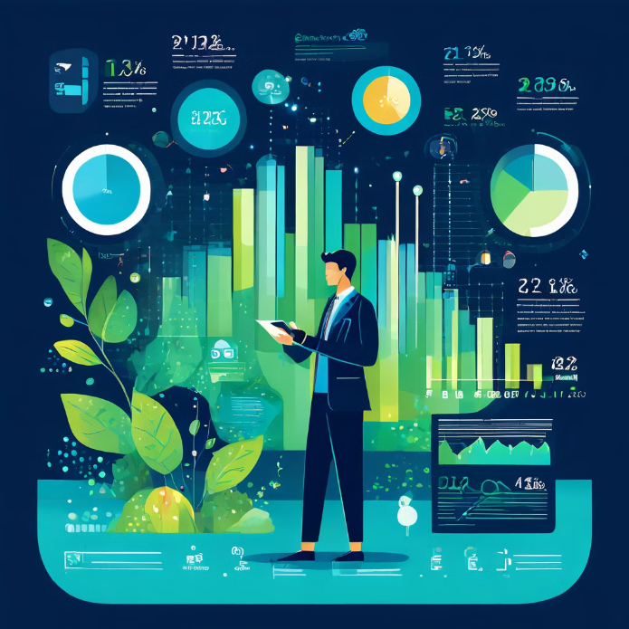
ABSTRACT(CONTINUATION)
Carbon footprint calculators help individuals estimate their personal CO2 emissions.
Quantifying individual carbon footprints is crucial for reducing emissions and promoting environmental responsibility.

Slide 6




ABSTRACT(CONTINUATION)
Decreasing Usage
Study Focus
Evaluation Criteria
Decreasing usage of these tools highlights the need for improved usability.
This study focuses on the usability of a specific calculator including awareness games.
Usability was evaluated based on Nielsen's usability principles.

Slide 7

INTRODUCTION
Human activities are significantly impacting the Earth's climate. The burning of fossil fuels, deforestation, and industrial processes release large amounts of greenhouse gases, primarily carbon dioxide (CO2), into the atmosphere.

Slide 8



INTRODUCTION (CONTINUATION)
This has led to a rise in global temperatures, causing a cascade of environmental problems.
We are witnessing changes in weather patterns, such as more frequent and intense heatwaves, increased rainfall, and more severe storms.

Slide 9

INTRODUCTION (CONTINUATION)
These changes have significant consequences, including disruptions to agriculture, rising sea levels, and threats to biodiversity.
Addressing these challenges requires a collective effort to reduce our carbon footprint.

Slide 10
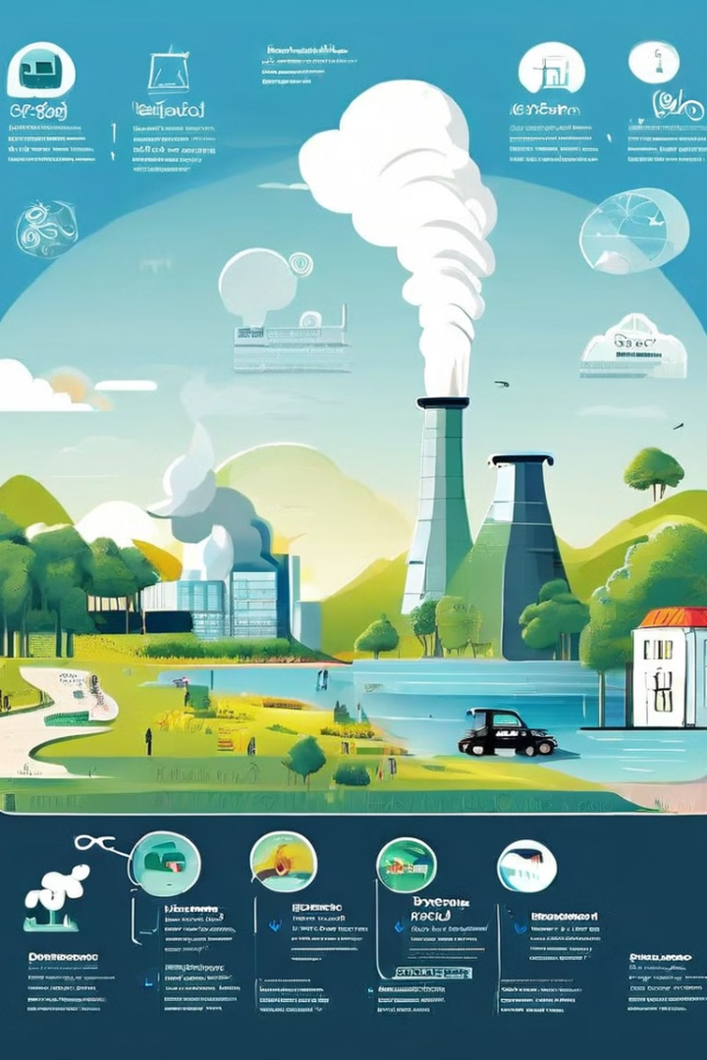




CARBON FOOTPRINT CALCULATION STEPS
Identify operations that produce GHG
Collect data
Find operation specific emission factors
Calculate & implement carbon footprint

Slide 11

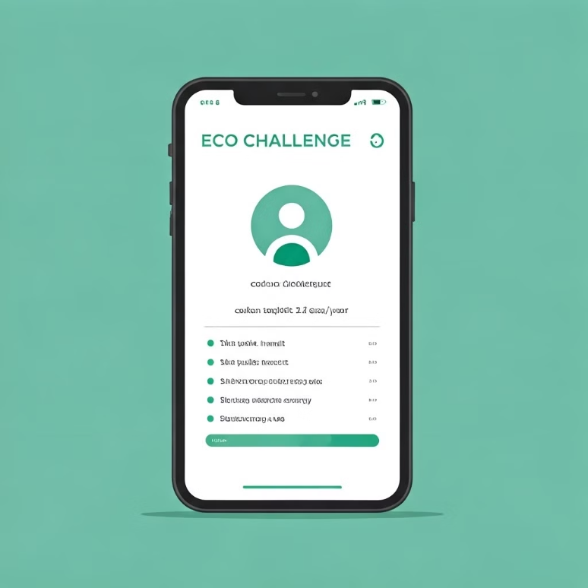
Eco Challenge is a modern web-based tool designed to empower individuals and households to measure and manage their carbon footprint effectively.
Unlike traditional environmental assessment methods that rely on generalized data, this app offers a personalized, step-by-step approach to sustainability.

Slide 12


The project addresses the growing need for practical tools that bridge the gap between environmental awareness and actionable change.
Ultimately, Eco Challenge seeks to contribute to global sustainability efforts through innovative technology.

Slide 13

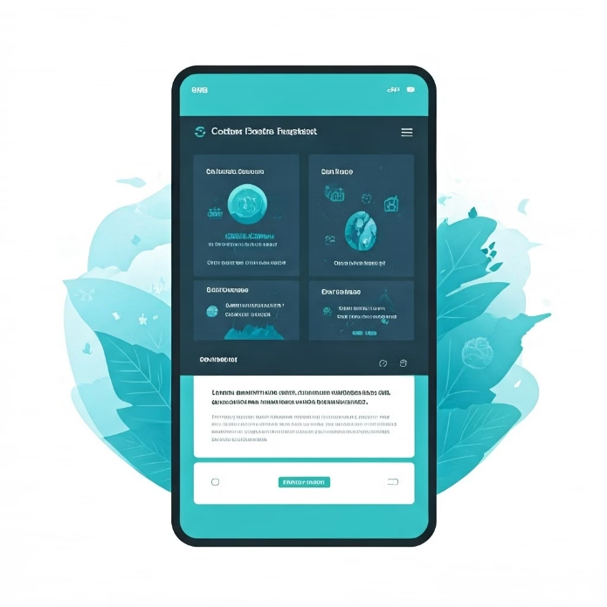
OBJECTIVES
Eco Challenge enhances carbon footprint tracking with a user-centric web and mobile app, converted to an APK using Capacitor for offline access. This ensures users can track their environmental impact anytime, anywhere, without relying on an internet connection.
The Carbon Footprint Calculator simplifies data entry, offers daily tracking, and connects behaviors to real-time environmental impact. It uses intuitive prompts to make input effortless while providing immediate feedback on emissions.

Slide 14

Features like Eco Run Adventure, Recycle module, and Water Conservation tool educate users, while gamification (e.g., increasing game difficulty) boosts engagement. These elements reward sustainable actions with points, encouraging long-term user participation.
A centralized Dashboard visualizes progress, high scores, and rewards, with localStorage ensuring data access without internet dependency. This allows users to monitor their environmental journey seamlessly across devices.

Slide 15
LITERATURE REVIEW
1. A Data Clustering and Machine Learning Based Approach to Measuring Urban Carbon Emissions
To measure urban carbon emissions by using a clustering algorithm
A multilayer perceptron model based on artificial neural networks (ANN) to explore the relationship between user data and carbon emissions
Aims to balance the accuracy and practicality of urban carbon emission measurements

Slide 16
Advantages:
-Achieves a balance of accuracy and practicality in carbon emission measurement.
-Uses machine learning to streamline the calculation process.
-Reduces the high costs associated with traditional measurement methods
Disadvantages:
-Requires a collection of user data including output value, electricity consumption, water usage, production costs, and pollutant emissions.
-The complexity of the model might require significant computational resources.

Slide 17

2. Platforms To Calculate Carbon Footprints: A Step Towards Environment Sustainability
-Discusses the issue of global warming and the increase in carbon emissions.
-Addresses the limitations of current carbon footprint calculation methods
-proposes a framework to calculate carbon footprints at both individual and industrial levels

Slide 18
Advantages:
-Aims to provide a solution for carbon footprint calculation at both individual and industrial levels.
-Identifies problematic areas and processes responsible for carbon emissions.
Disadvantages:
-The actual implementation and effectiveness of the AI-based solution recommendation system are not detailed.
-The framework's complexity and data requirements for both individual and industrial levels might be challenging.

Slide 19
3. Methods and Principles of Carbon Footprint Calculation. Relevance of Application of These Approaches in Russia and the World
-Discusses the issue of global climate change and the importance of transitioning to a carbon-free economy.
-Reviews the regulatory framework for the carbon agenda at national and corporate levels.
-Addresses the development of the carbon market and its impact on the Russian economy.

Slide 20
Advantages:
-Provides a comprehensive overview of the regulatory framework and calculation methods for carbon footprints.
-Discusses the importance of sustainable development and non- financial reporting.
-Addresses the speci ics of the carbon market and its implications for the Russian economy.
Disadvantages:
-Focuses heavily on the Russian context, which might limit its broader applicability.
-Points out the lack of standardized methodological guidelines in Russia.

Slide 21
4. Development of a Web Application for Individual Carbon Footprint Calculation
-Details the development of a web application designed to calculate the individual carbon footprint of Brazilians.
-Uses the GHG Protocol methodology for its calculations.
-Compares them with existing Brazilian calculators.

Slide 22
Advantages:
-Develops a tool to increase awareness about individual carbon footprints.
-Provides calculations based on a recognized methodology (GHG Protocol).
-Includes a usability test to evaluate the application.
Disadvantages:
-The application is tailored to the Brazilian context, limiting its global applicability.
-The paper mentions limitations in existing calculators, such as a lack of methodological standardization.

Slide 23
LITERATURE REVIEW
Overview of key studies analyzing urban carbon emissions and methodologies for calculation.
SL NO
AUTHOR
YEAR
TITLE
METHODOLOGY
OBSERVATIONS
1.
Linghan Xu, Jiaqi Zhang
2023
A Data Clustering and Machine Learning Based Approach to Measuring Urban Carbon Emissions
Clustering algorithms group users; a neural network model predicts carbon emissions for all users.
Multilayer perceptron model accurately predicts carbon emissions, making calculations efficient.

Slide 24
LITERATURE REVIEW
SL NO
AUTHOR
YEAR
TITLE
METHODOLOGY
OBSERVATIONS
2.
Ariel Carlos Peres Vieira, Eliton Matheus Freitas da Silva, Valguima Victoria Viana Aguiar Odakura
2021
Development of a Web Application for Individual Carbon Footprint Calculation
Regulation of greenhouse gas emissions is a major focus for businesses and governments, but Russia lacks comprehensive guidelines, training materials, and research tailored to both global standards and local economic realities for carbon impact calculations.
The current lack of comprehensive guidelines and resources in Russia hinders accurate carbon impact calculations. Developing training materials and research aligned with global standards and local economic needs is essential to bridge this gap.

Slide 25

LITERATURE REVIEW
SL NO
AUTHOR
YEAR
TITLE
METHODOLOGY
OBSERVATIONS
3.
Chinmayee Chatterjee, Rishab Gupta, Khushi Gupta, Nitasha Hasteer
2023
Platforms To Calculate Carbon Footprints: A Step Towards Environment Sustainability
Platform to calculate carbon footprints for individuals and industries using machine learning. It also tracks past records and provides personalized solutions to reduce emissions.
Current calculators lack industry-level options and custom recommendations. The new platform fills these gaps with accurate calculations and tailored solutions.

Slide 26
LITERATURE REVIEW
SL NO
AUTHOR
YEAR
TITLE
METHODOLOGY
OBSERVATIONS
4.
Ariel Carlos Peres Vieira, Eliton Matheus Freitas da Silva, Valguima Victoria Viana Aguiar Odakura
2023
Development of a Web Application for Individual Carbon Footprint Calculation
Testing 10 carbon footprint calculators using a profile that covers common categories found in most calculators, with an evaluation based on input variety, user details, and other factors. A standardized test profile was developed, incorporating input values for each category to assess the calculators' accuracy.
Variations in results among the calculators, with no clear transparency on data origin or emission factors. Need for more standardization and transparency in carbon footprint calculators to improve user trust in the results.

Slide 27


EXISTING SYSTEM
•Current systems primarily use clustering algorithms and machine learning models, such as multilayer perceptron, to predict carbon emissions by grouping users and analyzing operational data.
• While these systems can accurately predict emissions with low error, they lack industry-specific options and custom recommendations, limiting their applicability for varied users.

Slide 28

PROPOSED SYSTEM:
1. Eco Challenge enhances carbon footprint tracking with a user-centric web and mobile app, converted to an APK using Capacitor for offline access. This ensures users can track their environmental impact anytime, anywhere, without relying on an internet connection.
2. The Carbon Footprint Calculator simplifies data entry, offers daily tracking, and connects behaviors to real-time environmental impact. It uses intuitive prompts to make input effortless while providing immediate feedback on emissions.

Slide 29
PROPOSED SYSTEM:
3. Features like Eco Run Adventure, Recycle module, and Water Conservation tool educate users, while gamification (e.g., increasing game difficulty) boosts engagement. These elements reward sustainable actions with points, encouraging long-term user participation.
4. A centralized Dashboard visualizes progress, high scores, and rewards, with localStorage ensuring data access without internet dependency. This allows users to monitor their environmental journey seamlessly across devices.

Slide 30

METHODOLOGY
Front End: Developed the user interface using HTML for structure, CSS for styling, and JavaScript for interactivity, ensuring a responsive design with fade-in animations across pages like country.html and results.html.
Back End: Operated as a client-side app with no server-side back end, relying on JavaScript for all processing, calculations, and data storage via localStorage for seamless data flow between pages.
Libraries and Frameworks: Utilized no external libraries for the web app to keep it lightweight, but incorporated Capacitor to convert the web app into a native Android app, enabling cross-platform deployment.
Platforms: Built and tested on modern web browsers (Chrome, Firefox, Safari) for the web version, with Capacitor facilitating Android app deployment, ensuring accessibility on both desktop and mobile devices.

Slide 31
ALGORITHMS USED
The Eco Challenge app employs a linear calculation algorithm to compute the carbon footprint by multiplying user inputs (e.g., electricity kWh, travel km) with predefined emission factors, summing the results across categories like electricity, fuel, travel, and meals.
JavaScript functions validate inputs using conditional checks to ensure values are non-negative and within acceptable ranges (e.g., renewable percentage between 0 and 100).
A categorization algorithm classifies the total emissions into Low (< 2 tonnes), Average (2–4 tonnes), or High (> 4 tonnes) risk levels, triggering tailored suggestions.

Slide 32




SYSTEM REQUIREMENTS
Hardware: Any device with a modern web browser (laptop, smartphone, tablet) or an Android device (for the app version) with at least 2GB RAM for smooth performance.
Software: Web browser (e.g., Chrome, Firefox, Safari) with JavaScript enabled for the web version; Android 8.0+ for the Capacitor-built app.
Development Tools: HTML, CSS, JavaScript for the web app; Capacitor for Android deployment; no server-side requirements (client-side app).
Optional: Internet connection for live demos hosted on GitHub Pages or to access updated emission factors.

Slide 33
PROJECT OUTLINE
Phase 1: Conducted requirement analysis and designed HTML pages for structured data collection across categories like household, electricity, and travel.
Phase 2: Developed JavaScript logic for carbon footprint calculations, data storage using localStorage, and risk categorization with personalized suggestions.
Phase 3: Styled the app with CSS to ensure a responsive, user-friendly interface with smooth transitions like fade-in animations.
Phase 4: Tested the app for accuracy, usability, and performance, deploying it for web and Android using Capacitor, with results displayed on results.html.

Slide 34
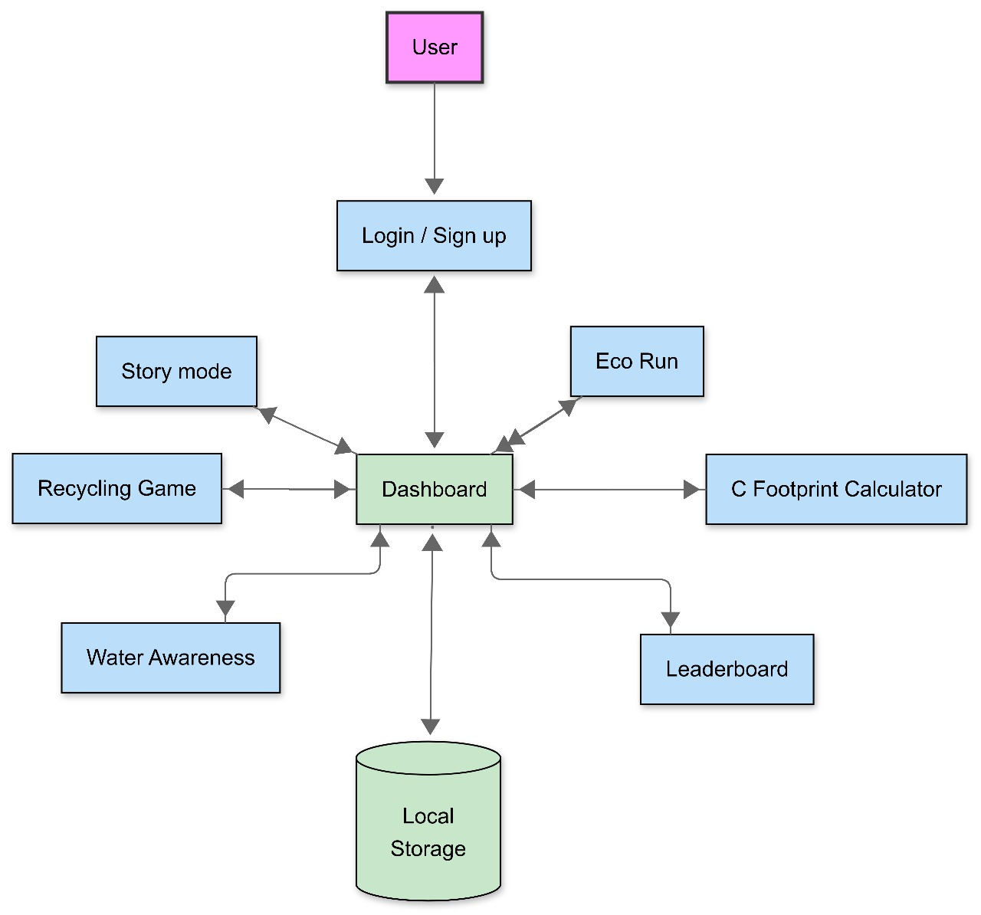
ARCHITECTURE DIAGRAM

Slide 35
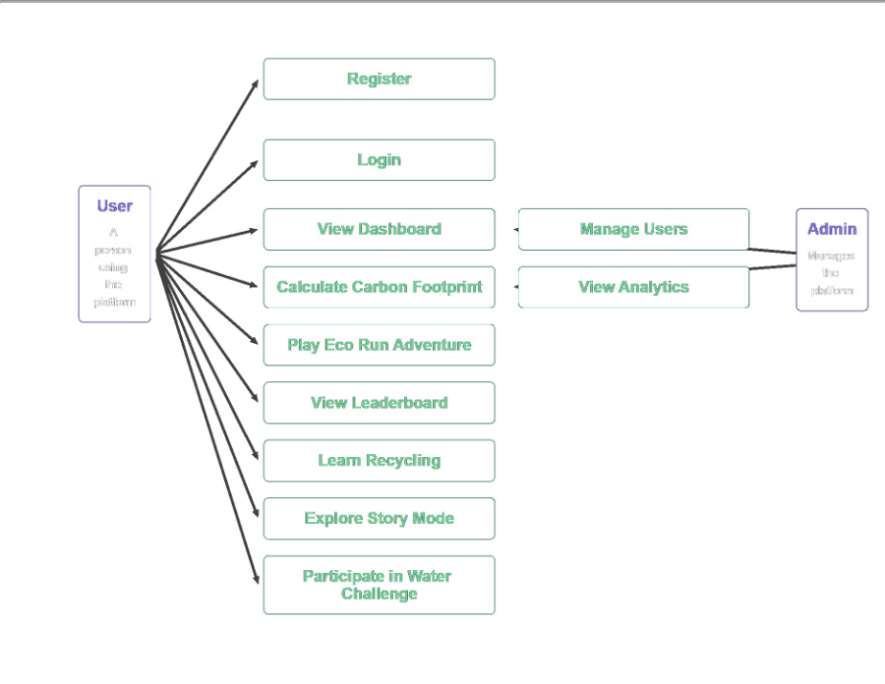
USE CASE DIAGRAM

Slide 36
CONCLUSION
Eco Challenge successfully delivers an intuitive tool for tracking carbon footprints, promoting sustainable living through technology.
It addresses gaps in existing systems by providing personalized feedback, daily tracking, and gamified engagement.
Future enhancements could include API integration for real-time emission data, expanded gamification, and support for iOS devices.
The project highlights the power of technology in fostering environmental consciousness and driving impactful change.

Slide 37

REFERENCES
Platforms To Calculate Carbon Footprints: A Step Towards Environment Sustainability. Chinmayee Chatterjee; Rishab Gupta; Khushi Gupta; Nitasha Hasteer. (https://ieeexplore.ieee.org/document/10141821)
Methods and Principles of Carbon Footprint Calculation. Relevance of Application of These Approaches in Russia and the World. Tuchin Mikhail Vitalievich; Chekryzhov Arkadiy Kirillovich; Kalistratova Alina Aleksandrovna; Ivanov Mikhail Vitalievich; Rozhok Anastasiia Pavlovna. (https://ieeexplore.ieee.org/document/10086925)
Development of a Web Application for Individual Carbon Footprint Calculation. Ariel Carlos Peres Vieira; Eliton Matheus Freitas da Silva; Valguima Victoria Viana Aguiar Odakura. (https://ieeexplore.ieee.org/document/9640099)
A Data Clustering and Machine Learning Based Approach to Measuring Urban Carbon Emissions. Linghan Xu; Jiaqi Zhang. (https://ieeexplore.ieee.org/document/10255820)

Slide 38
Thank you for your time!
We appreciate your interest in our 'Eco Challenge' project.

